Slide 1

Vidya Poshak
Supporting Economically Challenged Students Education
Gift a Graduate DREAM

Slide 2
Who We Are
Vidya Poshak, is a registered NGO serving education community from 2001.
We strongly believe Education is the solution for Ending Poverty. When we invest in a Young, economically challenged meritorious youth for a few years, we can break the poverty cycle of a family forever.
Nurture Merit Program Is a well-designed, structured and focused program to support bright students coming from economically challenged families for their Higher Education to complete their Graduation degree leading to a meaningful employment/self employment.

Slide 3
Nurturmerit program components
Financial Assistance: This will cover college fees, transportation and exam fees. Along with this additional amount for coaching is given for a few performers. For some extreme need based cases (10%) additional amount is also given to cover room and boarding
Knowledge Center Services: Reference books, Career Counseling, Online Webinars, Mentoring Activities, Industry visits and Monthly workshops are provided to the students.
Bridge Training through Residential Camps: Every student will be provided with various skill and need based trainings to enhance communication/life skills and employment opportunities. Along with this to ensure creating good, sensitive citizens for the society.

Slide 4
Calendar of Events
Online Application form
March 2020- May 2020
Completion of telephonic interview and shortlisting the student
June 1st
First level shortlisting students based on Merit & documents 15-20th May, 2020.
Completion of house visit (Senior volunteers, Youth volunteers and staff)
15t^{h} June, 2020.
Submission of required documents by students
30 June, 2020.
Financial Assistance program for both New and Renewal students – July, 2020.
Residential Training for students
Feb/Mar/Apr
Quarterly touch points with students
Sep /Dec/Mar/June
Half yearly report to donors
Nov 2020
Final Report & Utilization
May 2021

Slide 5
Student Selection Process
Student application process starts from Feb Mid Onwards
Initial Student Application form will be online and can be filled using Mobile.
3 Levels of Screening process
First level screening : SSLC Marks & Based on the documents uploaded (Electricity Bill + Ration Card + Bank Pass Book)
Second Level Screening : Telephonic Interviews will be conducted by Volunteers and will be hosted by VP Team.
Third level Screening : Dwelling unit visits by Volunteers to meet the parents & assess the poverty condition.
Eligibility for Science (85% marks in Science +Maths +English)
Support amount to be transferred to the students’ account directly to their account.
Financial Support details
Financial support for Non Professional (PUC & Degree) students upto INR 15,000
Financial support for Professional is upto INR 40,000/- & above based on donors wish
Agri & Allied courses , (Nursing , Horticulture, Fisheries etc.) Support up to INR25000/-
Higher level of Poverty and higher level of merit will get priority for support

Slide 6
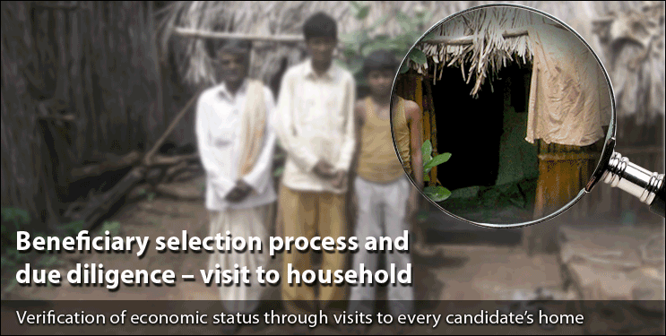
Unique Identification Process
- Volunteers visits students home.
Students selected based on Financial condition & Merit
One on one sponsor connection to student.
Support extended till student achieves highest degree of academic excellence.

Slide 7
Reporting System & Transparency
Support given in the Donor Name and the beneficiaries will be directly linked with the donors.
Profiles & Contact details with phone numbers of all supported students will be provided to the donor.
Beneficiary students will write personal letters to the donors informing about their progress in studies & support received.
Direct transfer of support to student accounts only.
Audited Fund utilization statement will be provided to the donor at the end of the financial year.
As and when required the donor can visit the beneficiary house to meet them and their parents

Slide 8
Compliance
Graded by CRISIL as “Strong in Delivery Capability”
Vidya Poshak follows all the Norms set by the Credibility Alliance & Credibility Assurance.
Valid 80G / 12AA Certificate , FCRA Compliance.
The accounts are maintained through advanced and updated computerized systems.
All audit reports & annual report copies kept transparently in our website.
Employee details , Board members details & salary details kept transparently in website.
Utilization certificate provided to all donors.

Slide 9
Volunteering Opportunity for employees
Mentoring – Provide one on one mentoring & support them to realize their Dreams. (Will provide Orientation for mentoring)
Selection process of Students – Tele Interviews, House visits
Workshops - Conduct workshops on (In person & Zoom Webinar)
Facing Interviews
Life Skills / Soft Skills
Critical Thinking
Be a role model & share ur experience
eVidyaloka Program – Weekly two online classes for Rural Higher Primary school children (Class 6 & 7 Maths, Science & English) – Only native kannada speaking volunteer

Slide 10
Impact so far
In all 4600 graduates have settled through gain full employment in their life and brought their families out the clutches of economic backwardness.
More than 1,35,000 Youth empowered with skill training through various program like RBC, ELAAP, C-Doss, ELIP.
1,87,000 students benefitted from Vidya Poshak’s library services through 5 Library branches and 30 Book banks.
14,500 students were supported and taken to the next level of literacy who otherwise would have discontinued their education after Class-10
INR 400 Million Rupees invested in Empowering Educational Community

Slide 11

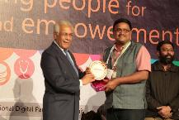
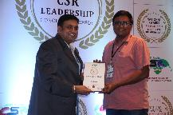
Unique Features
CRISIL Graded Vidya Poshak as “Strong in Delivery Capability”
More than 600 volunteers provide their Time, Knowledge & Expertise as free service involving in all the activities.
Vidya Poshak is the regional finalist of Apeejay India Volunteer award for 2011
Technology Development is one of the key focus for Vidya Poshak
Winner 2016 Spirit of Humanity award for “Excellence in Education”
Winner 2013 eNGO challenge for South Asia for Organizational Efficiency among 260 contestants.
Vidya Poshak follows all the Norms set by the Credibity Alliance & Credibility Assurance.

Slide 12
Thank You

